Slide 1
Agenda
Typescript
Angular Features
Why Angular
Angular Architecture
Bootstrapping & Compilation
Angular CLI
Components
Modules
Templates, Interpolation, Directives
Life Cycle Hooks
Binding
Pipes
Forms
Angular Material
Services & Dependency Injection
Routing & Navigation
Http, Observables, RxJs
Authentication
State
Unit Testing
Deployment

Slide 2
JavaScript Journey
Brendan Eich of NetScape 1995; initially it was named Mocha, later renamed to LiveScript, and finally JavaScript.
1995 – Netscape passed JavaScript to the European Computer Manufacturers Association (ECMA) for standardization
1997 - the first standard version of JavaScript, ECMAScript 1, was released.
1998 - ECMAScript 2 was released the next year, with minimal changes to the previous version to keep up with the ISO standard for the language.
1999 - ECMAScript 3 was released with introduction of the language’s regular expression and exception handling features.
2003 - ECMAScript 4 was abandoned
2009 - ECMAScript 5 and came with lots of new features including support for the parsing of JSON files.
2009 - commonJS project is created
2015 - ECMAScript 6 was renamed to ECMAScript 2015 (ES2015), and this naming pattern has continued for the latest releases of the JavaScript standard. Every year June month the standards are released.
Currently Standard ES2020 is approved.
https://en.wikipedia.org/wiki/ECMAScript
And “JavaScript is every where”

Slide 3
JavaScript Journey
Brendan Eich of NetScape 1995; initially it was named Mocha, later renamed to LiveScript, and finally JavaScript.
1995 – Netscape passed JavaScript to the European Computer Manufacturers Association (ECMA) for standardization
ECMA–262 1st Edition June 1997
ISO/IEC 16262 Approved April 1998
ECMA–262 2nd Edition June 1998
ECMA–262 3rd Edition December 1999
ECMA–262 5th Edition December 2009
ECMA–262 5.1 Edition June 2011

Slide 4
What’s the problem with Javascript
Application scale JavaScript development is hard.
JavaScript was designed for small things
When building large applications the JavaScript code gets complex; it becomes extremely hard to maintain.
Dynamic typing
Lack of compile time type checking
Scope can’t be defined at block level
Lack of modularity
OOPS is hard (eg Based on object extension. Not class inheritance )

Slide 5
Problem - dynamic types
Variables are untyped and dynamic. They are flexible
Bad because it is so easy to get wrong
var x = 1; var y = x + 1; // OK, type is inferred. can assume x and y are both numbers.
var x = 1; x = "hello"; // NOT OK, type is mixed up. We can't assume what type is x.
// JS is interpreted. There are no design-time intellisense or compile-time assistance to help you point out errors

Slide 6
Problem - scope
JavaScript's scope looks like C#, but does not work at a block level. It is at the function level.
It is so easy to get wrong
var i = 1; if (i == 1) { var i = 2; } var y = function { var i = 3; }
Notes:
// not a reference to coffeescript
// y is function closure - exposes an inner function, allowing the inner variable x.foo to be modified externally.
// extremely important in event handling, but difficult without strong coffee.

Slide 7
Typescript overview
“TypeScript is a typed superset of JavaScript that compiles to plain JavaScript.”
Any browser. Any Host. Any OS. Open source.
Typescript was first made public in October 2012
Anders Hejlsberg, lead architect of C# and creator of Delphi and Turbo Pascal, has worked on the development of TypeScript
Made in Microsoft in 2012 and released as version 0.8
TypeScript adopts its basic language features from the ECMAScript5 specification
Around 30 versions released so far, latest being 3.9 released on May 2020.
Version 4.0 beta is now available.

Slide 8
Why Typescript?
Starts with JavaScript
All JavaScript code is TypeScript code
JavaScript libraries work with TypeScript
Optional static types, classes, modules
Enable scalable application development and excellent tooling
Type inference and structural typing
*In practice very few type annotations are necessary
Zero cost: Static types completely disappear at run-time
Ends with JavaScript
Compiles to idiomatic JavaScript
Runs in any browser or host, on any OS
JS
TS
JS
JS
TS Code
Compile to JavaScript

Slide 9
Why Typescript?
TypeScript is a language for application scale JavaScript development.
Modular Development
Scalable HTML5 client side development
Static Typing / Optional Typing
Disappear at runtime with zero cost
Compilation
Syntax checking, type checking, com
Type Definitions (.d.ts extension)
Provides definitions for external JS libraries.
OOP
Classes, Interfaces, modules etc

Slide 10
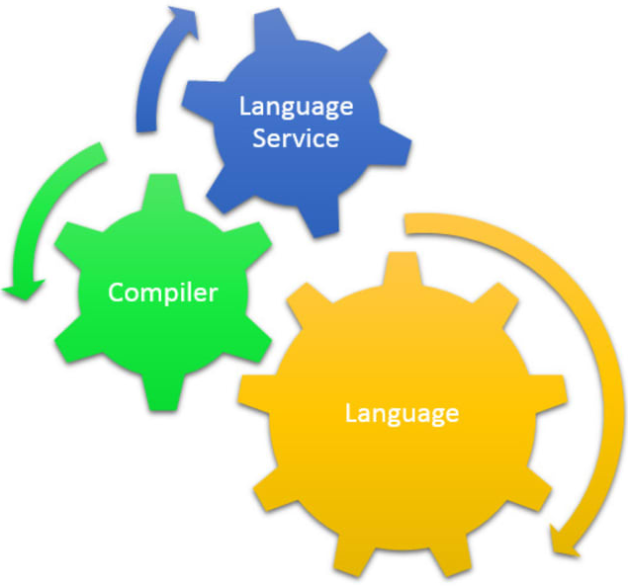
TypeScript comprises of …
Language
Compiler – open source, written in Typescript
Tooling - Visual Studio language service, browser hosted playgroundLibraries
Libraries - Static typing of DOM, jQuery, node.js

Slide 11
Type Annotation
Types
Any Type is a super set of all types
Number, Boolean, String, Arrays, enum, Tuple
Object Types
Classes, Modules, Interfaces
void
Used as the return type of functions that don’t return any value

Slide 12
Classes and modules
Scalable application structuring Classes, Modules, and Interfaces enable clear contracts between components
Aligned with emerging standards
Class, Module, and Arrow Function syntax aligns with ECMAScript 6 proposals
Supports popular module systems
CommonJS and AMD modules in any ECMAScript 3 compatible environment

Slide 13
TypeScript Lab
https://www.typescriptlang.org/index.html

Slide 14
Angular Journey
2010 – Angular JS released
AngularJs built on the concept of “scope” and controllers,
2016 – Angular 2 Released
Angular is a complete rewrite of AngularJS
An Angular application and its architecture are different from AngularJS. The main building elements for Angular are modules, components, templates, metadata, data binding, directives, services, and dependency injection
Angular 2 also recommends using the TypeScript language
Support reactive programming using RxJS
Angular 3
Angular 3 was not launched due to misalignment in Angular’s router packaging which was already distributed as v3.3.0 at that time.

Slide 15
Angular Journey
2017 - Angular 4
Introducing HttpClient, a smaller, easier to use, and more powerful library for making HTTP Requests.
New router life cycle events for Guards and Resolvers.
Allowed adding BrowserAnimationsModule in NgModule.
Angular 4 is compatible with TypeScript 2.1 and TypeScript 2.2.
Angular Universal: The vast majority of the Angular Universal code has been merged into Angular core.
2017 – Angular 5
support for progressive web apps, a build optimizer and improvements related to Material Design
@angular/http is replaced with @angular/common/http library.
An improved compiler that supports incremental compilation meaning faster rebuilds.
RxJS (reactive programming library) has been updated to version 5.5.2 or later.
2018 – Angular 6
Features like : ng update, ng add, Angular Elements, Angular Material + CDK Components, Angular Material Starter Components, CLI Workspaces, Library Support, Tree Shakable Providers, Animations Performance Improvements, and RxJS v6.
Added a new command to manage npm dependencies — ng update, ng add
Angular Material + CDK Components.
Angular Elements
Ivy Renderer
Service Worker
Schematics

Slide 16
Angular Journey
2018 – Angular 7
Angular 7 was released on October 18, 2018. Updates regarding Application Performance, Angular Material & CDK, Virtual Scrolling, Improved Accessibility of Selects, now supports Content Projection using web standard for custom elements, and dependency updates regarding Typescript 3.1, RxJS 6.3, Node 10
Drag & Drop API has been added.
Supported Virtual Scrolling.
CLI Prompts have been added.
Angular Elements now supports content projection using web standards for custom elements.
2019 - Angular 8
Featuring Differential loading for all application code, Dynamic imports for lazy routes, Web workers, TypeScript 3.4 support, and Angular Ivy as an opt-in preview. Angular Ivy opt-in preview includes:
Generated code that is easier to read and debug at runtime
Faster re-build time
Improved payload size
Improved template type checking
Route Configurations use Dynamic Imports using loadChildren.
Added Web Worker Support.
Much-anticipated Ivy compiler as an opt-in feature.

Slide 17
Angular Journey
2020 - Angular 9
Version 9 moves all applications to use the Ivy compiler and runtime by default. Angular has been updated to work with TypeScript 3.6 and 3.7. In addition to hundreds of bug fixes, the Ivy compiler and runtime offers numerous advantages:
Smaller bundle sizes
Faster testing
Better debugging
Improved CSS class and style binding
Improved type checking
Improved build times, enabling AOT on by default
Improved Internationalization
2020 - Angular 10 was released on June 24, 2020.
New date range picker.
Warnings about CommonJS imports
Optional stricter settings that can improve maintainability, help catch bugs, and enable advanced optimizations.
New versions supported of TypeScript 3.9, TSLib 2.0, TSLint 6.
New Default Browser Configuration
Deprecating support for older browsers including IE 9, 10, and Internet Explorer Mobile

Slide 18
Features & Benefits
CROSS PLATFORM
Progressive Web Apps
Use modern web platform capabilities to deliver app-like experiences. High performance, offline, and zero-step installation.
Native
Build native mobile apps with strategies from Cordova, Ionic, or NativeScript.
Desktop
Create desktop-installed apps across Mac, Windows, and Linux using the same Angular methods you've learned for the web plus the ability to access native OS APIs.
SPEED AND PERFORMANCE
Code Generation
Angular turns your templates into code that's highly optimized for today's JavaScript virtual machines, giving you all the benefits of hand-written code with the productivity of a framework.
Universal
Serve the first view of your application on Node.js®, .NET, PHP, and other servers for near-instant rendering in just HTML and CSS. Also paves the way for sites that optimize for SEO.
Code Splitting
Angular apps load quickly with the new Component Router, which delivers automatic code-splitting so users only load code required to render the view they request.
PRODUCTIVITY
Templates
Quickly create UI views with simple and powerful template syntax.
Angular CLI
Command line tools: start building fast, add components and tests, then instantly deploy.
IDEs
Get intelligent code completion, instant errors, and other feedback in popular editors and IDEs.
FULL DEVELOPMENT STORY
Testing
With Karma for unit tests, you can know if you've broken things every time you save. And Protractor makes your scenario tests run faster and in a stable manner.
Animation
Create high-performance, complex choreographies and animation timelines with very little code through Angular's intuitive API.
Accessibility
Create accessible applications with ARIA-enabled components, developer guides, and built-in a11y test infrastructure

Slide 19
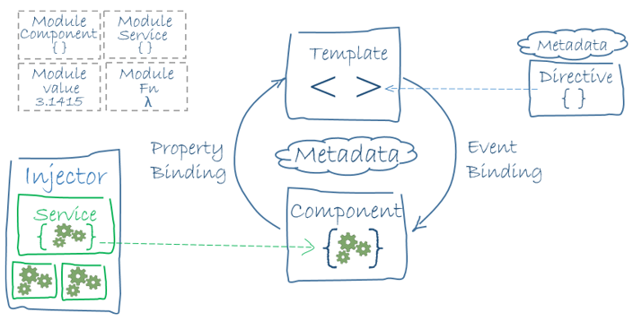
Architecture

Slide 20
Angular CLI
Command Line Interface for building Angular applications
analytics Configures the gathering of Angular CLI usage metrics. See https://angular.io/cli/usage-analytics-gathering.
build (b) Compiles an Angular app into an output directory named dist/ at the given output path. Must be executed from within a workspace directory.
deploy Invokes the deploy builder for a specified project or for the default project in the workspace.
config Retrieves or sets Angular configuration values in the angular.json file for the workspace.
doc (d) Opens the official Angular documentation (angular.io) in a browser, and searches for a given keyword.
e2e (e) Builds and serves an Angular app, then runs end-to-end tests using Protractor.
generate (g) Generates and/or modifies files based on a schematic.
help Lists available commands and their short descriptions.
lint (l) Runs linting tools on Angular app code in a given project folder.
new (n) Creates a new workspace and an initial Angular app.
run Runs an Architect target with an optional custom builder configuration defined in your project.
serve (s) Builds and serves your app, rebuilding on file changes.
test (t) Runs unit tests in a project.
update Updates your application and its dependencies. See https://update.angular.io/
version (v) Outputs Angular CLI version.
xi18n (i18n-extract) Extracts i18n messages from source code.

Slide 21
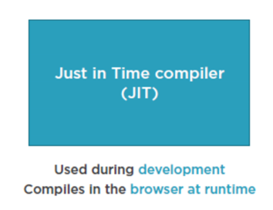
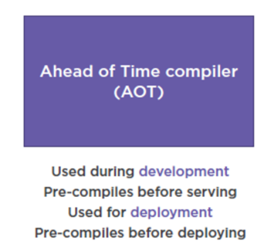
Compilation

Slide 22
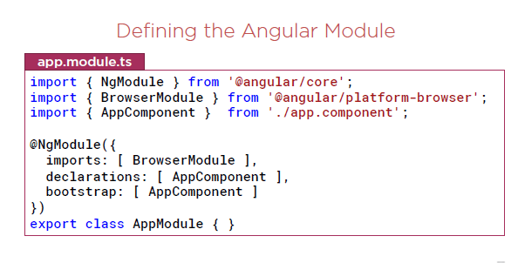
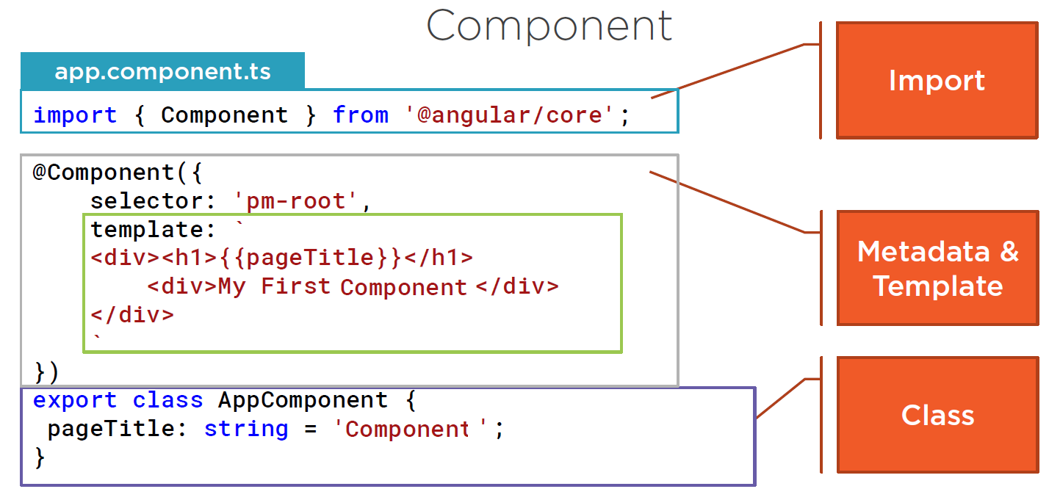
Modules

Slide 23
Templates, Interpolation, and Directives
Interpolation
One way binding
From component class property to an element property.
Defined with double curly braces
- Contains a template expression
- No quote needed
Directive (
Structural Directives
*ngIf: If logic
*ngFor: For loops

Slide 24
Templates, Interpolation, and Directives
Interpolation
<h1>{{pageTitle}}</h1>
{{'Title: ' + pageTitle}}
{{2*20+1}}
Directive -
Custom HTML element or attribute used to power up and extend our HTML.
Custom
Built-In

Slide 25
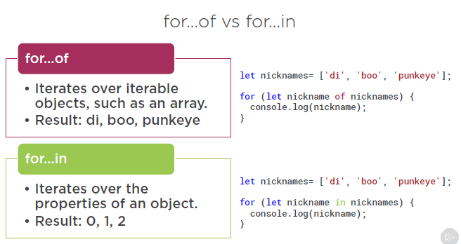
Directives
NgFor
- Show template variable
*ngFor='let product of products'>

Slide 26
Binding & Pipes
Binding
Coordinates communication between the component's class and its template and often involves passing data.
Pipes
Transforming Data
Pipe Examples
{{ product.productCode | lowercase }}
<img [src]='product.imageUrl'
[title]='product.productName | uppercase'>
{{ product.price | currency | lowercase }}
{{ product.price | currency:'USD':'symbol':'1.2-2' }}

Slide 27
Life Cycle Hooks
Hooks for the Component
constructor
This is invoked when Angular creates a component or directive by calling new on the class.
ngOnChanges
Invoked every time there is a change in one of th input properties of the component.
ngOnInit
Invoked when given component has been initialized. This hook is only called once after the first ngOnChanges
ngDoCheck
Invoked when the change detector of the given component is invoked. It allows us to implement our own change detection algorithm for the given component.
ngOnDestroy
This method will be invoked just before Angular destroys the component. Use this hook to unsubscribe observables and detach event handlers to avoid memory leaks.
Hooks for the Component’s Children
These hooks are only called for components and not directives.
Note
We will cover the difference between Components and Directives in the next section.
ngAfterContentInit
Invoked after Angular performs any content projection into the component’s view (see the previous lecture on Content Projection for more info).
ngAfterContentChecked
Invoked each time the content of the given component has been checked by the change detection mechanism of Angular.
ngAfterViewInit
Invoked when the component’s view has been fully initialized.
ngAfterViewChecked
Invoked each time the view of the given component has been checked by the change detection mechanism of Angular.

Slide 28
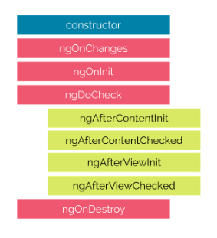
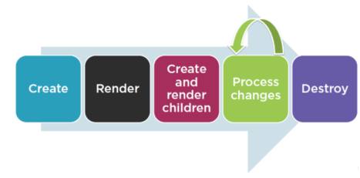
Life Cycle Hooks

Slide 29
Angular Material
Features
In-built responsive designing.
Standard CSS with minimal footprint.
Includes new versions of common user interface controls such as buttons, check boxes, and text fields which are adapted to follow Material Design concepts.
Includes enhanced and specialized features like cards, toolbar, speed dial, side nav, swipe, and so on.
Cross-browser, and can be used to create reusable web components.
Extensible
Angular Material is by design very minimal and flat.
It is designed considering the fact that it is much easier to add new CSS rules than to overwrite existing CSS rules.
It supports shadows and bold colors.
The colors and shades remain uniform across various platforms and devices

Slide 30
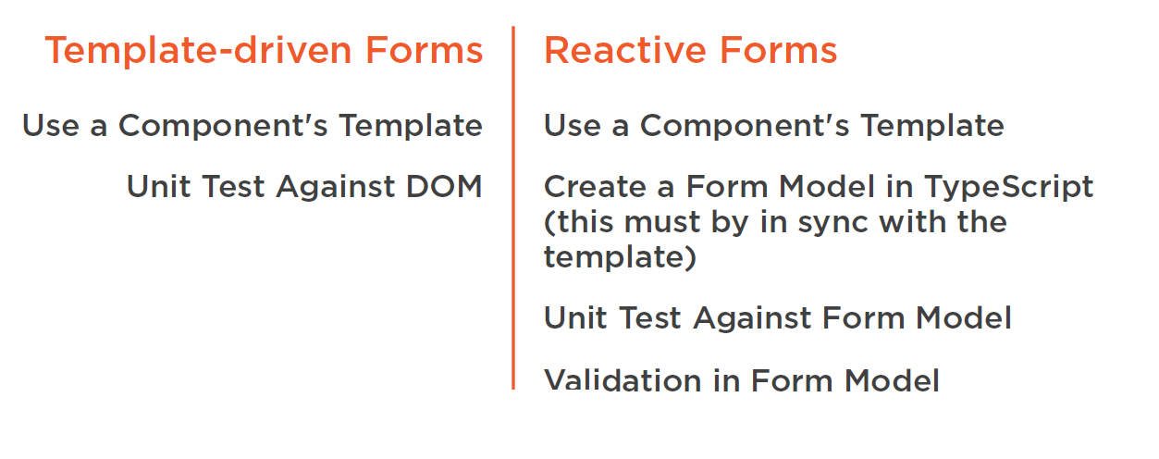
Forms

Slide 31
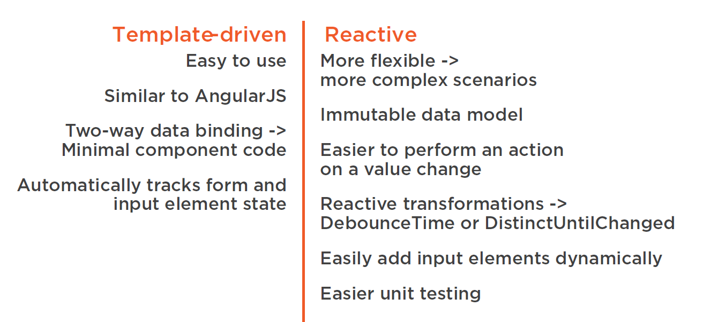
Forms

Slide 32
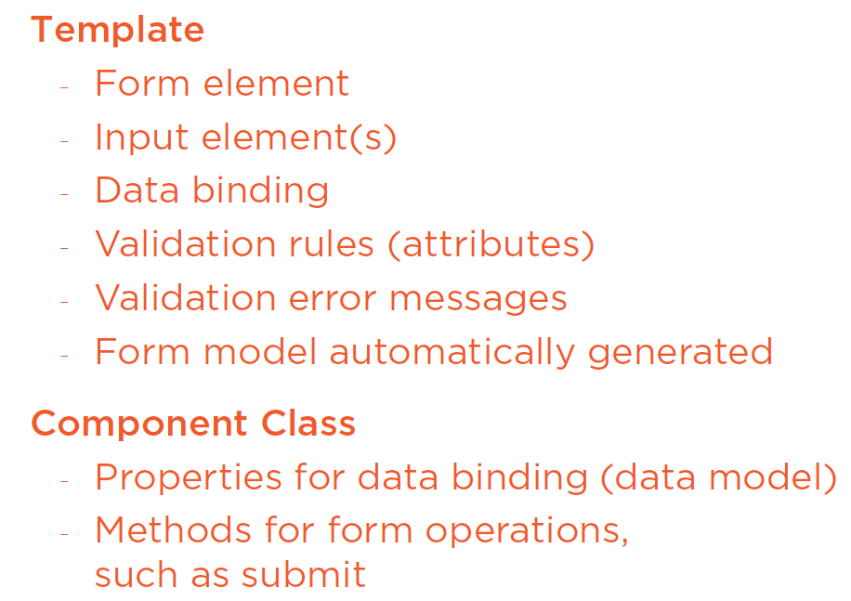
Template Driven Forms

Slide 33
Data Binding in Forms
Using NgForm
<form #form=“ngForm”>
NgModel
Builds form.value
name attribute is required
Creating a Data Model
interface
Two-way Data Binding
[(ngModel)]=“variable”

Slide 34
HTML 5 Validation
required, pattern
minlength, maxlength, min, max

Slide 35
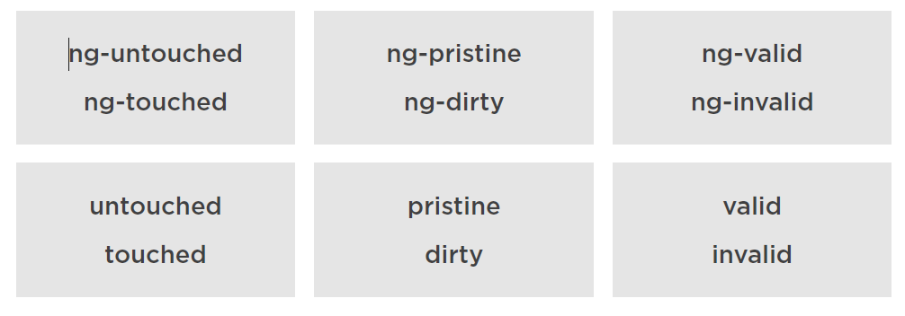
CSS Classes for Validation
Classes & Associated NgModel properties

Slide 36
https://github.com/DeborahK/Angular-ReactiveForms

Slide 37
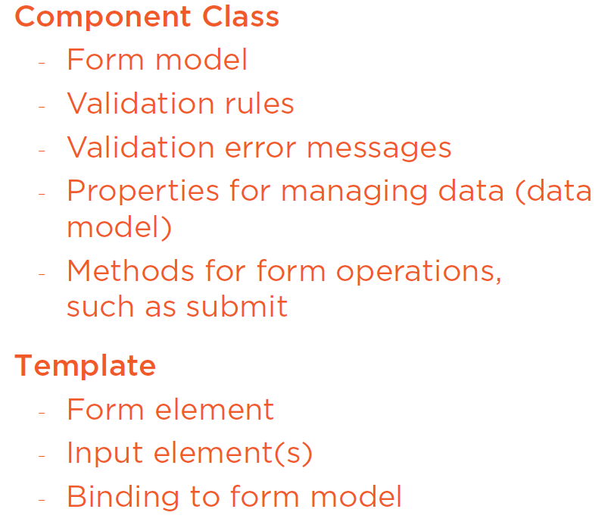
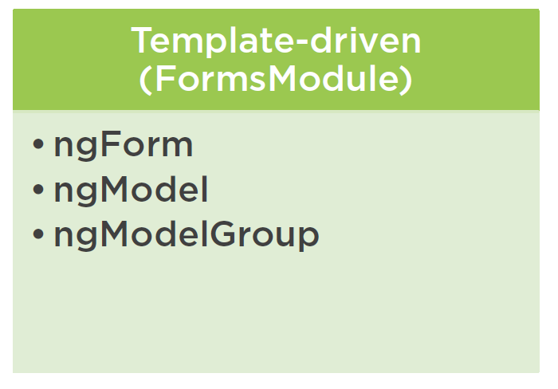
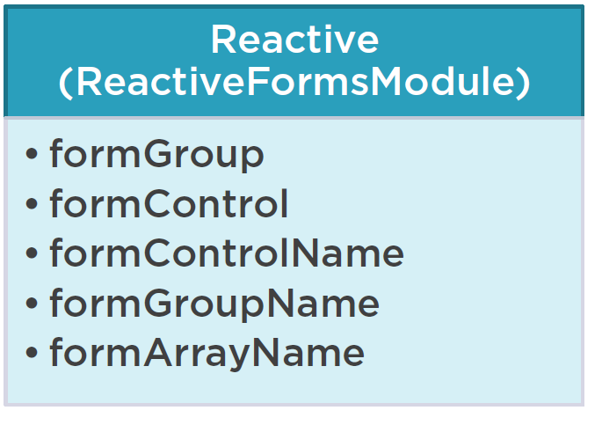
Reactive Forms

Slide 38
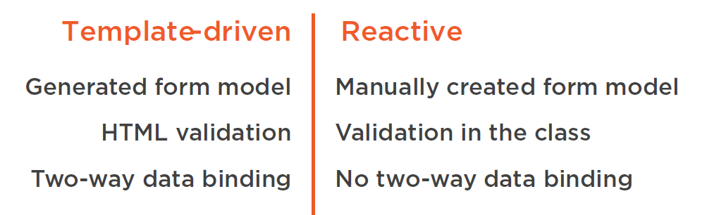
Angular Lab

